Slide 1
BACKEND-CHATAPP WITH NODE JS AND MONGOB
TASK-4

Slide 2

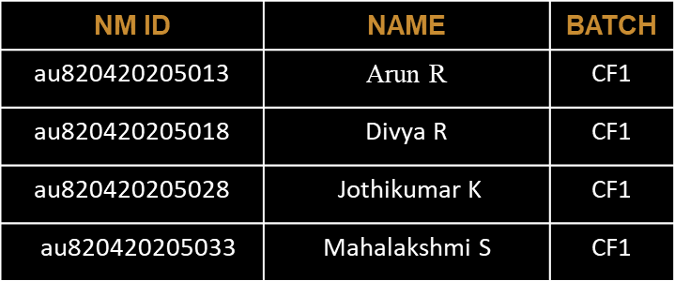
BACKEND-CHATAPP WITH NODE JS AND MONGOB
Chatting app allows you to communicate with your customers in web chat rooms. It enables you to send and receive messages. Chatting apps make it easier, simpler, and faster to connect with everyone and it is also easy to use. There are many types of chatting apps and every one has its own format, design, and functions.

Slide 3
Task 4 :: Dynamic Frontend
Integrate the APIs to frontend to ensure the dynamic feature of website
Point base api to the severs base url
Design api calls for each element
Handle errors in the output
Render output of apis to different low level components
Secure content of post apis
Evaluation Metric:
100% Completion of the above tasks
Learning outcome
Developing complicated UI using HTML components
Using props drilling and context to pass variables
Getting familiar with different type of api calls
Handling different input data

Slide 4
Step-Wise Description
Certainly! Here's a stepwise description of how to create the backend for a chat application using MongoDB and Node.js:
Set Up Your Development Environment - Install Node.js and npm (Node Package Manager) on your development machine. - Set up a MongoDB database, either locally or using a cloud-based MongoDB service.
Initialize Your Node.js Project - Create a new directory for your project. - Run `npm init` to create a `package.json` file, which will manage your project's dependencies.
Install Required Packages - Install necessary Node.js packages, such as Express for creating a web server, Mongoose for MongoDB interaction, and other dependencies like authentication libraries if needed.
Design Your Database Schema - Define the structure of your MongoDB database. Create schemas for users, conversations, and messages
Set Up the Express.js Server- Create an Express.js server to handle HTTP requests.
Summary of your task
Certainly! The task involved providing a stepwise description for creating the backend of a chat application using MongoDB and Node.js. The steps included setting up the development environment, installing necessary packages, designing the database schema, implementing user authentication, enabling real-time messaging, message storage, defining API endpoints, ensuring security, optimizing for scalability, handling real-time notifications, testing, deployment, and ongoing maintenance. This process allows you to build a robust chat application backend that offers secure, real-time communication and data storage

Slide 5
Assessment Parameter
Design Schema for data to be stored
Point all routes with a appropriate controllers to control request and response
Set mongodb server on localhost
Check-List
Add authentication middleware to all protected routes
Add dummy data with schema in mongodb server
Filter and santize all the incoming data in http requests
Run some test queries to test the server
Set up secure environment variables for secret keys

Slide 6
Submission Github
https://github.com/ArunR4/NM2

